Slide 1





Foreground Characterization for the
Murchison Widefield Array's Northern
Sidelobe Using the VLA
Spring 2016 NASA Space Grant Symposium
University of Arizona, Tuscon, Arizona
Michael Busch
Dr. Judd Bowman
Dr. Danny Jacobs
Piyanat “Boom” Kittiwist

Slide 2
Outline of Talk
History of early Universe; the Epoch of Reionization
Goal: Map the evolution of structure of the early Universe using the Murchison Widefield Array (MWA).
Challenge: Bright radio galaxies are drown out reionization signal.
Idea!: Characterize bright galaxies with the Very Large Array (VLA), then we can subtract their signal from the EoR measurements.
End-goal: Simulate foreground impact on EoR measurements from VLA observations

Slide 3
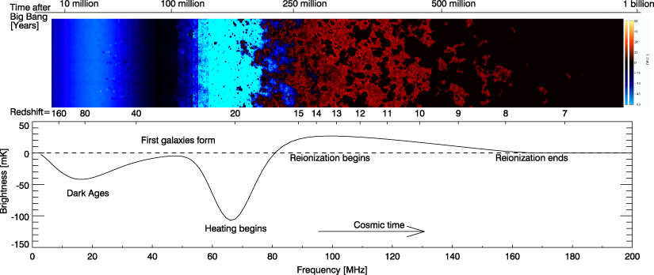
History of the Early Universe
The reionization history of the early universe, from Pritchard and Loeb 2012.

Slide 4
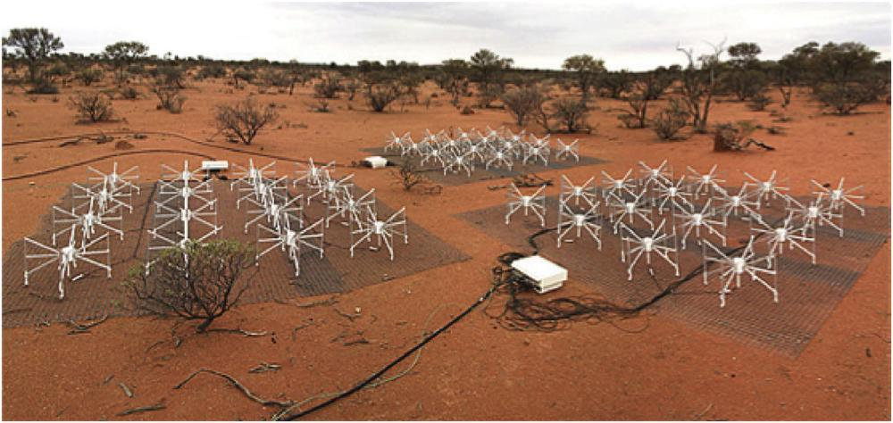
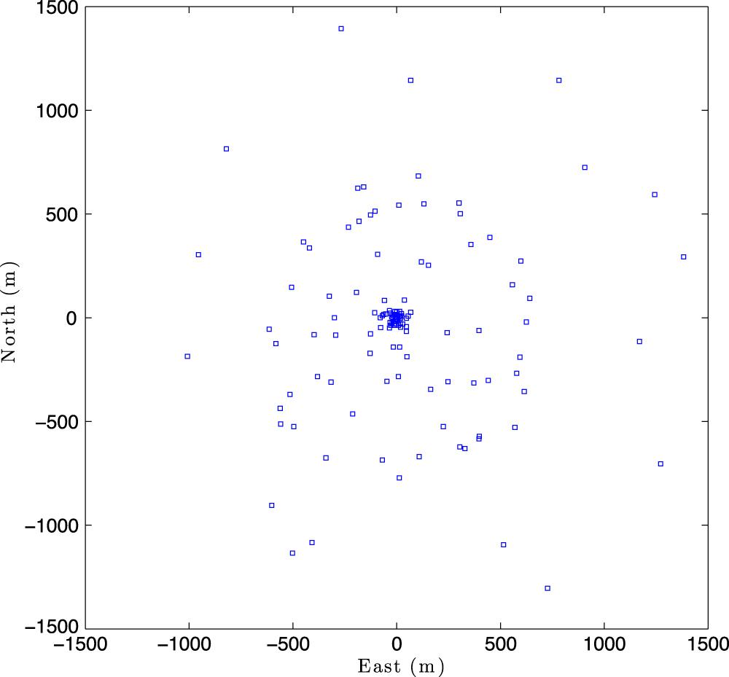
Murchison Widefield Array (MWA)
Radio array in Western Australia, radio quiet environment. Started operation in 2013. ASU is a partner.
Pathfinder (technology, skillset) for Square Kilometer Array (SKA).
2048 Antennas, 128 ‘Tiles’.
Epoch of Reionization (EoR) is main science target.
Both figures from Pober et al. 2016

Slide 5
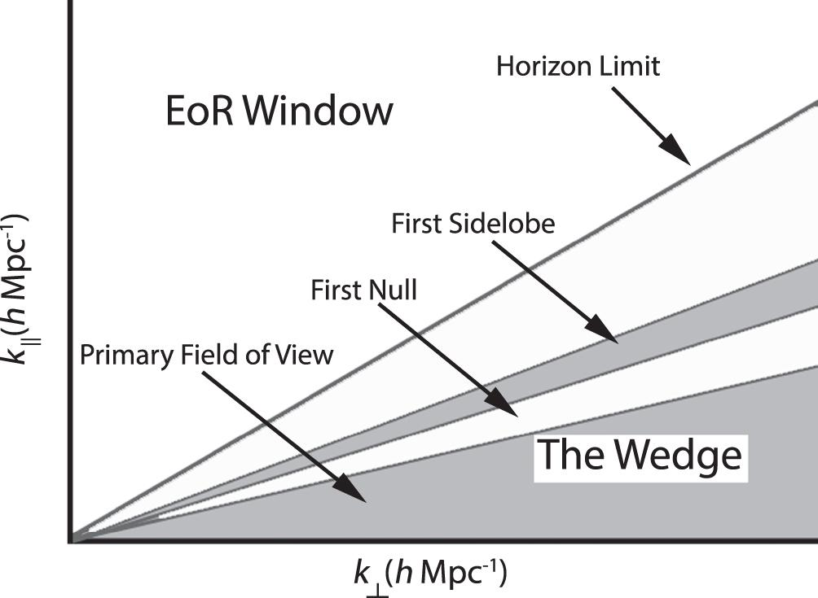
Foregrounds in the Primary Beam
Finding the reionization signal is tough.
Foregrounds are predicted to be 1,000-10,000 brighter than EoR signal.
Need foreground spectra to characterize foregrounds in order to remove.
Figure from Pober et al. 2016

Slide 6
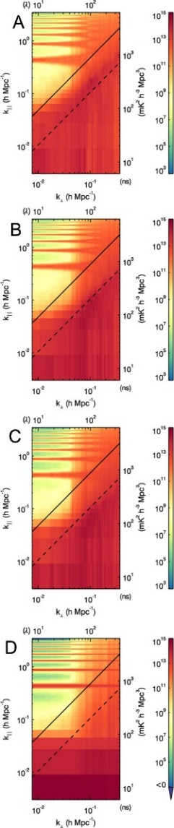
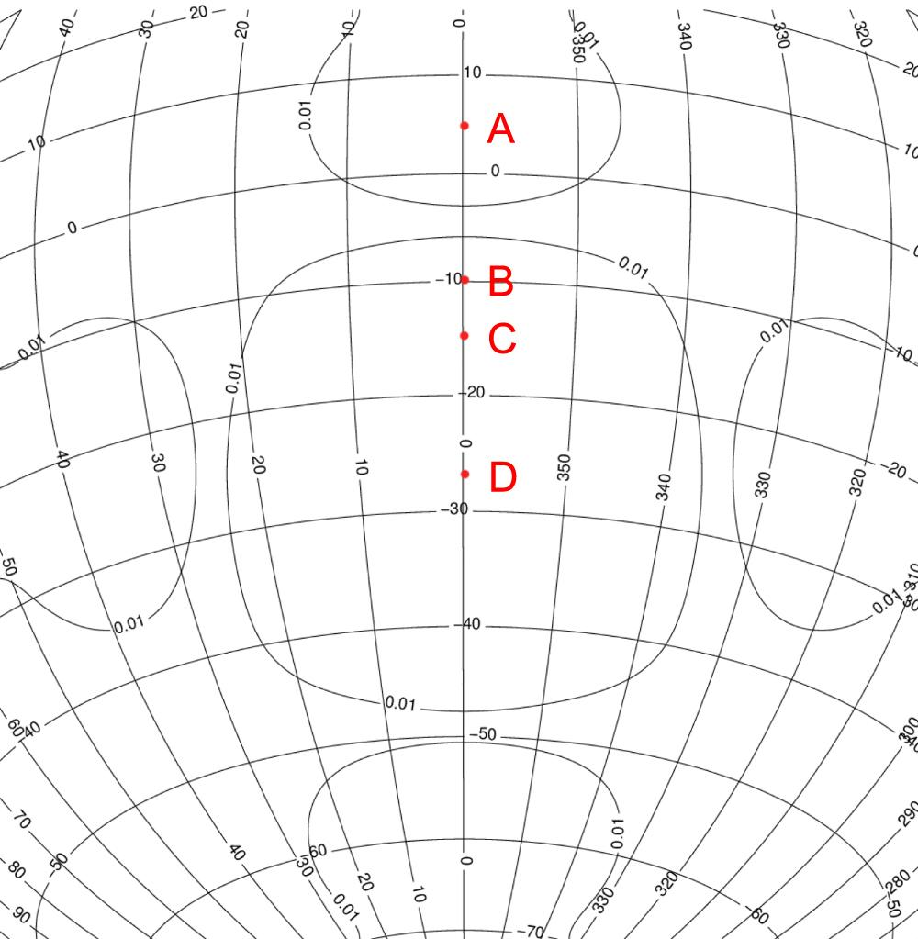
Foregrounds in the Primary Beam
Figures from Pober et al. 2016.

Slide 7
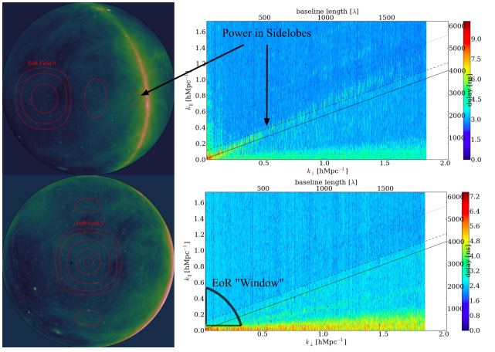
Power leakage into EoR window when the sidelobe is near Milky Way!

Slide 8
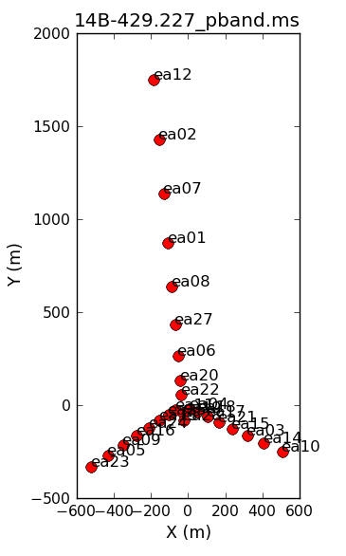
Observing with the VLA
We observed 68 bright radio sources in the northern sidelobe of the MWA’s primary beam in April of 2014.
The calibrator 0137+331=3C48 was also included in the observation, a primary calibrator for the MWA.
The P-band receiver (236-492 MHz) is the lowest frequency band currently available at JVLA and is the closest frequency band to the MWA EoR observation (140-200 MHz).
VLA has high spectral resolution.
Antenna Layout of the VLA

Slide 9
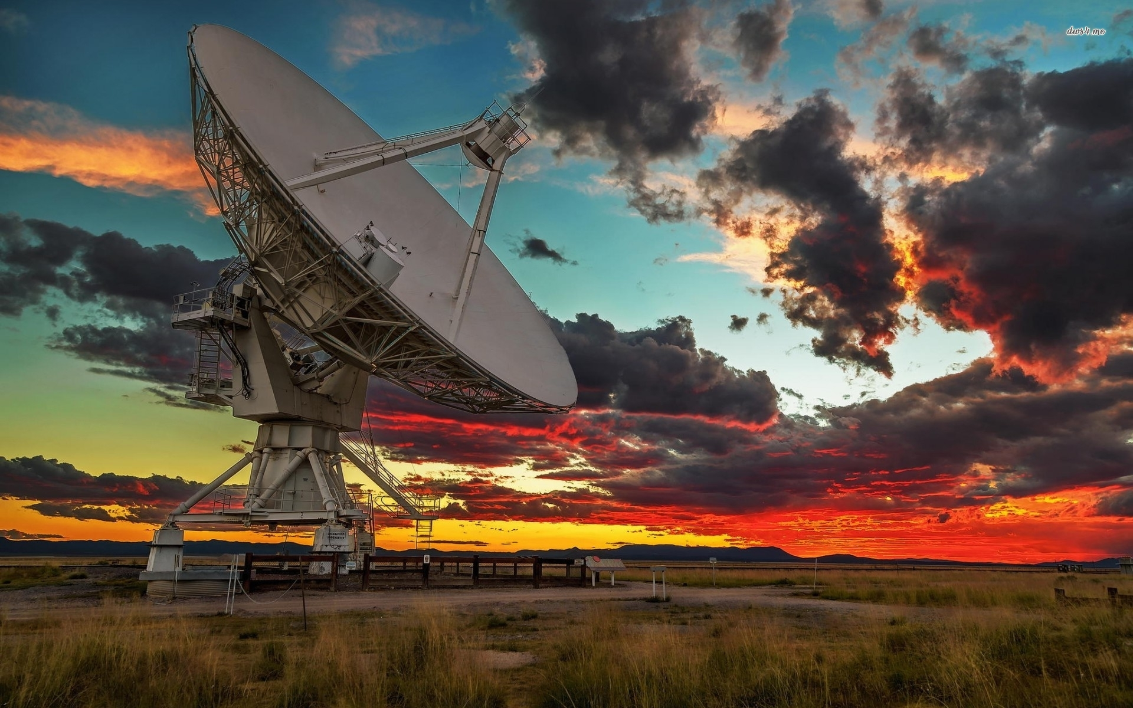
A VLA Antenna in Socorro, New Mexico.

Slide 10
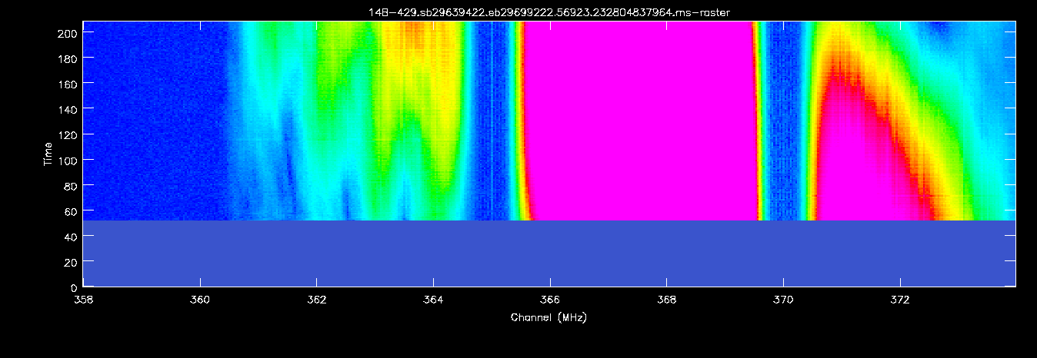
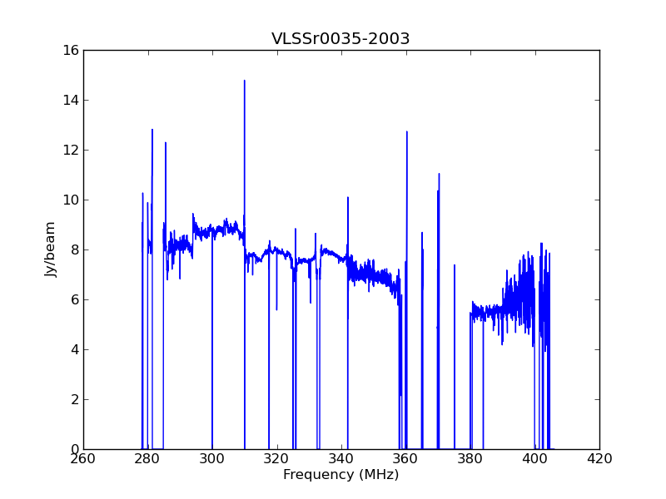
Challenges: Radio Frequency Interference
RFI environment in the P-band at the VLA site is not well known.
There is no single algorithm to get ride of RFI, most algorithms are bootstrapped.
Iterative process. Must get rid of bad data!
Bad RFI around ~360 MHz.
How RFI affects a spectrum.

Slide 11
Data Pipeline & CASA
All analysis of data is completed using CASA (Common Astronomical Software Applications) package, produced by the NRAO.
Radio frequency interference (RFI) needs to be flagged as bad data before, and after, calibrations are completed on all data sets.
Further calibrations are completed using gencal(), including the important phase and amplitudes calibrations using the calibrator 0137+331=3C48.
In order to ‘invert’ the data to create an image, the clean() command is invoked.
Spectra can be extracted using imstat() and Python directories or using the CASA command specfit().
RFI Flagging
flagdata()
Calibration
gencal()
Image
clean()
Make SEDs
specfit()

Slide 12
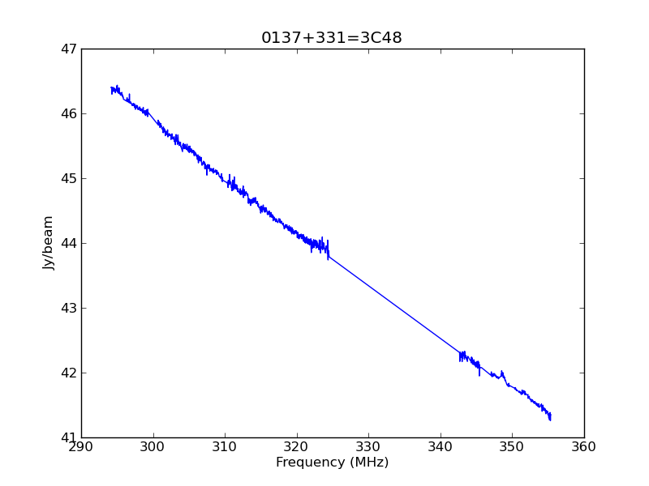
Results
In process of making and fitting spectra.
Want ~30 spectral indices of sources.
Have about 15 thus far.
Spectral Index = Alpha in this equation.
Both figures from Pober et al. 2016

Slide 13
Next Steps
Continue to make and fit spectra. This is an iterative process and RFI needs to be flagged for each target source. Manually and automatically.
Compile Spectral Indices, end of April goal is ~30.
In the Summer, calculate spectral indices for all sources and create a catalogue.
Calculate MWA Power Spectrum response to these sources by simulating them with their associated spectral indices.

Slide 14
Questions? / Acknowledgements
Thanks to the ASU Space Grant Staff:
  Dr. Thomas Sharp
  Candace Jackson (Retired)
  Michelle Tanaka (Retired)
  Desiree Crawl
My Mentors:
  Dr. Judd Bowman
  Dr. Danny Jacobs
  Meg Hufford
  Boom Kittiwisit
My Fellow Space Grant Fellows
The Arizona Space Grant Consortium for all the opportunities these past three years!

Slide 15
Table of Results
Source Name: 0137+331=3C48, Jy_mean: 44.184092353, Jy_err: 0.0459322035887, Freq_mean: 320.2069945, Freq_err: 0.560805579458, ModelAlpha: -0.6104603597
Source Name: VLSSr0150-2932, Jy_mean: 3.74815829228, Jy_err: 0.00843195824612, Freq_mean: 320.2069945, Freq_err: 0.560805579458, ModelAlpha: -1.9927808137
Source Name: VLSSr0130-2610, Jy_mean: 6.28292842236, Jy_err: 0.0207508354486, Freq_mean: 320.2069945, Freq_err: 0.560805579458, ModelAlpha: -1.82383535014
Source Name: VLSSr0102-2152, Jy_mean: 3.19216567787, Jy_err: 0.01747864844, Freq_mean: 320.2069945, Freq_err: 0.560805579458, ModelAlpha: -2.57100067364
Source Name: VLSSr0024-2928, Jy_mean: 8.77114612945, Jy_err: 0.0161712035998, Freq_mean: 339.130394204, Freq_err: 0.686109653019, ModelAlpha: -2.92087051853
Source Name: VLSSr0035-2003, Jy_mean: 6.86050272702, Jy_err: 0.0156637605234, Freq_mean: 339.130394204, Freq_err: 0.686109653019, ModelAlpha: -7.51584265867
Source Name: VLSSr0003-1727, Jy_mean: 6.60013450208, Jy_err: 0.0169386063718, Freq_mean: 339.130394204, Freq_err: 0.686109653019, ModelAlpha: -0.512915764835
Source Name: VLSSr0059-1700, Jy_mean: 5.06528939407, Jy_err: 0.018070479956, Freq_mean: 339.130394204, Freq_err: 0.686109653019, ModelAlpha: -2.91846908647
Source Name: VLSSr0018-1242, Jy_mean: 7.18327199742, Jy_err: 0.0156314023568, Freq_mean: 339.130394204, Freq_err: 0.686109653019, ModelAlpha: -0.154837354841
Source Name: VLSSr0018-1022, Jy_mean: 4.01763016366, Jy_err: 0.0205288101562, Freq_mean: 339.130394204, Freq_err: 0.686109653019, ModelAlpha: 1.0224813503
Source Name: VLSSr0054-0333, Jy_mean: 7.24493131876, Jy_err: 0.014374180439, Freq_mean: 339.130394204, Freq_err: 0.686109653019, ModelAlpha: -4.39380585194
Source Name: VLSSr0038-0207, Jy_mean: 17.0293790754, Jy_err: 0.031545108251, Freq_mean: 339.130394204, Freq_err: 0.686109653019, ModelAlpha: 0.296561052365
Source Name: VLSSr0041-0143, Jy_mean: 4.11366240212, Jy_err: 0.0263236977458, Freq_mean: 339.130394204, Freq_err: 0.686109653019, ModelAlpha: 0.459104721169
Source Name: VLSSr0037-0109, Jy_mean: 13.5028208174, Jy_err: 0.536846257225, Freq_mean: 339.130394204, Freq_err: 0.686109653019, ModelAlpha: 1.04717369225
Source Name: VLSSr0006-0004, Jy_mean: 8.61071859234, Jy_err: 0.948612343221, Freq_mean: 339.130394204, Freq_err: 0.686109653019, ModelAlpha: -0.209761172877
Source Name: VLSSr0033+0628, Jy_mean: 1.2629442425, Jy_err: 0.272874864669, Freq_mean: 339.130394204, Freq_err: 0.686109653019, ModelAlpha: -1.37265014584
Source Name: VLSSr0040+1003, Jy_mean: 11.9768485094, Jy_err: 0.0447662842594, Freq_mean: 339.130394204, Freq_err: 0.686109653019, ModelAlpha: 0.682697141079
Source Name: VLSSr0037+1319, Jy_mean: 6.7394599836, Jy_err: 0.0150170091991, Freq_mean: 339.130394204, Freq_err: 0.686109653019, ModelAlpha: -0.560562532763

